Slide 1

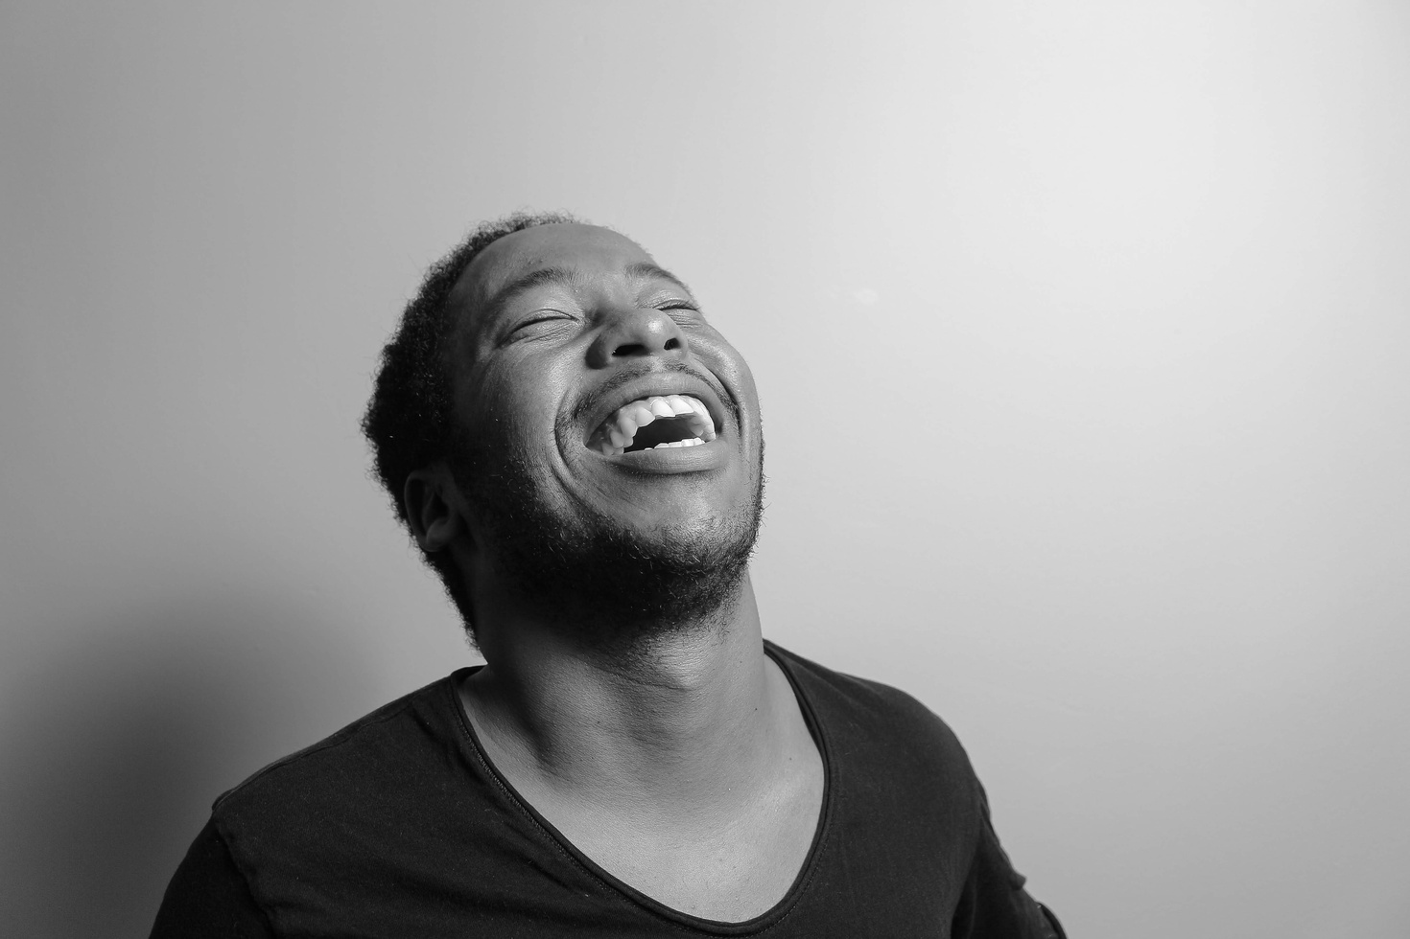
Pitch
Deck
Daniel Gallego
www.reallygreatsite.com

Slide 2


@@TO$$
@@in$$
Daniel Gallego
www.reallygreatsite.com

Slide 3


Problem
@@PS1T$$
@@PS2T$$
@@PS1$$
@@PS2$$
Daniel Gallego
www.reallygreatsite.com

Slide 4
Solution
@@S1t$$
@@S2t$$
@@S1$$
@@S2$$
Daniel Gallego
www.reallygreatsite.com

Slide 5
Business Model
@@B1$$
Daniel Gallego
www.reallygreatsite.com

Slide 6


Market Opportunity
@@MO1t$$
@@MO2t$$
@@MO1$$
@@MO2$$
Daniel Gallego
www.reallygreatsite.com

Slide 7
Team
@@T1$$
@@T2$$
Project Manager
Project Manager
Daniel Gallego
www.reallygreatsite.com

Slide 8
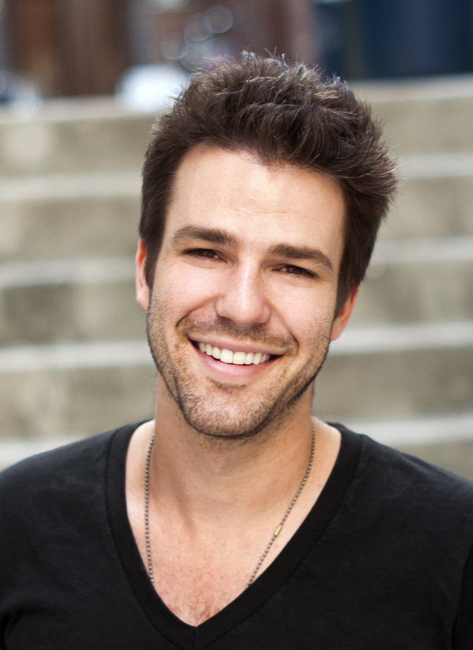
Team
@@T3$$
Project Manager
Daniel Gallego
www.reallygreatsite.com

Slide 9
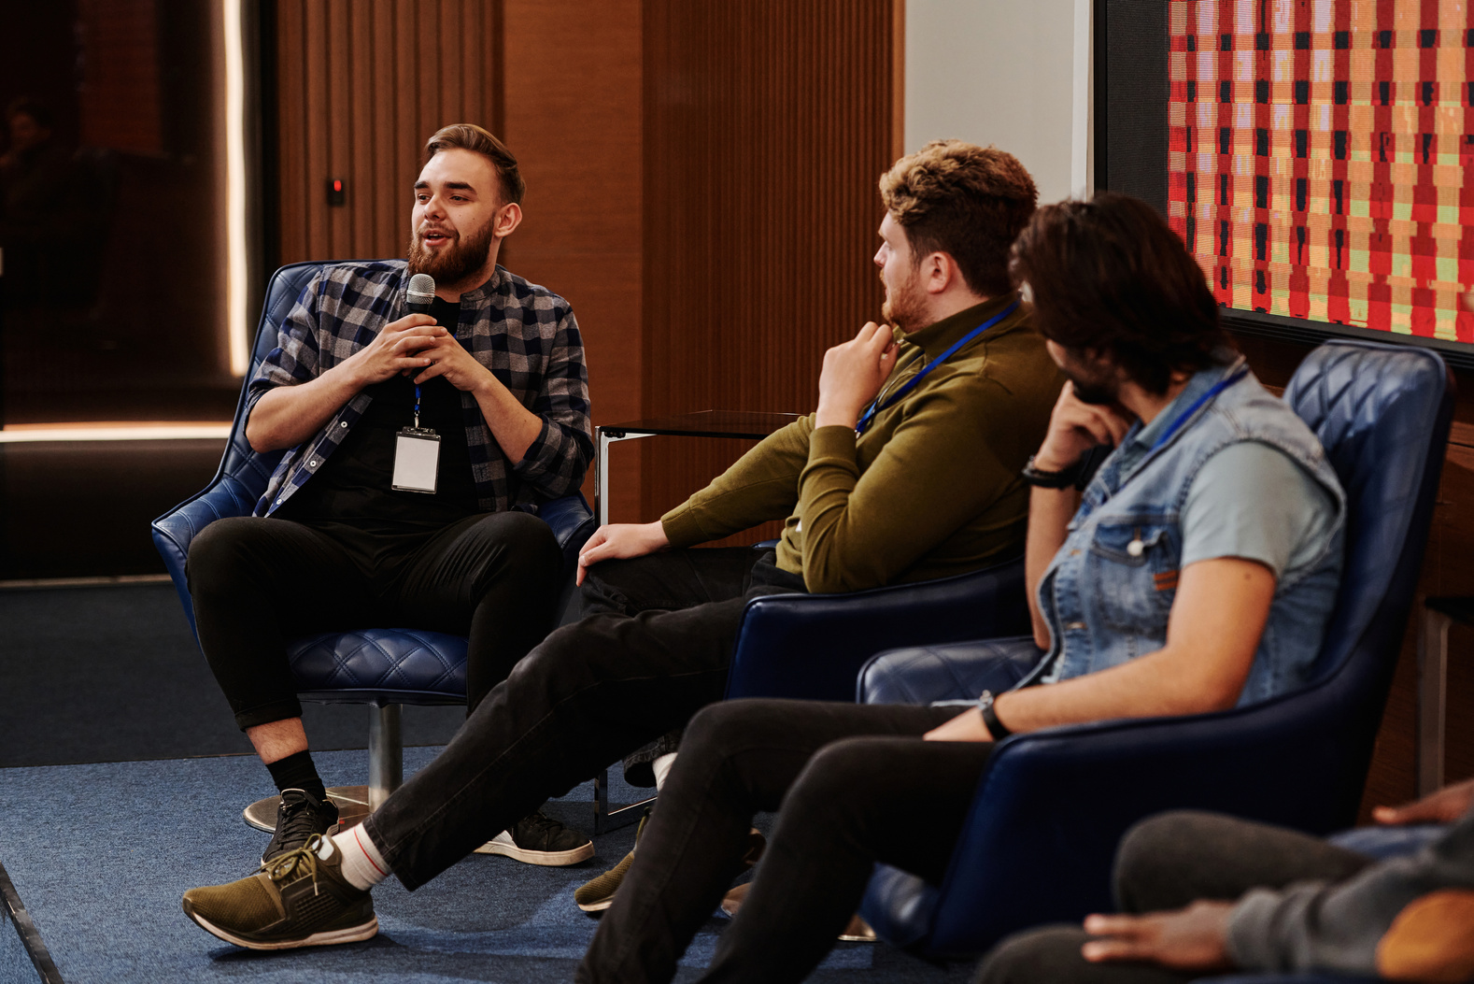


Contact
@@CD$$
@@AD$$
Daniel Gallego
www.reallygreatsite.com

